Slide 1
Ggplot2 and interactive graphics with R
Christophe Ladroue
SECTION 08
VIDEO 05
Building our dashboard
www.PacktPub.com

Slide 2
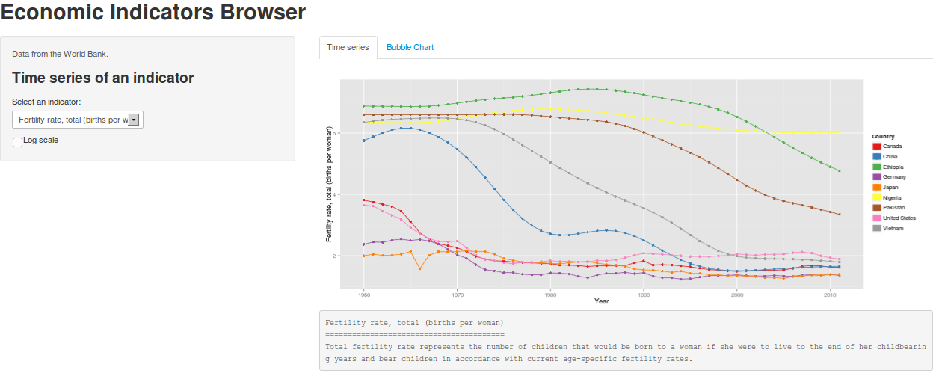
In this video we took a look at
how to put the time course plot, the bubble chart and the conditional panels together to build our dashboard.

Slide 3
In this section we’re going to take a look at
Designing the dashboard
Building the time series plot
Making a bubble chart in ggplot2
Making conditional panels
Building our dashboard

